Slide 1
Intro to Cryptography
CS 161 Fall 2022 - Lecture 5

Slide 2
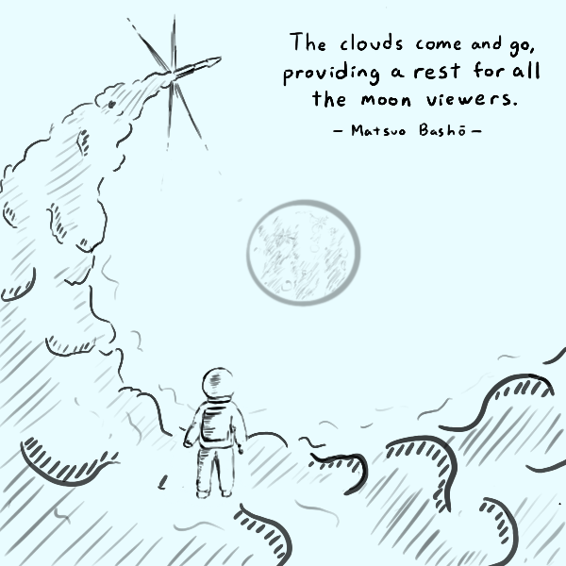
Announcements
Project 1 has been released
The checkpoint (Q1–Q4) are due Friday, September 16th at 11:59 PM PT
The full project (Q1–Q7 plus write-up) are due Friday, September 30th at 11:59 PM PT
See calendar for latest discussion and OH schedule
Notes:
Want to submit an announcements doodle? Email evanbot@berkeley.edu or post on Piazza!

Slide 3
Combining Mitigations
Textbook Chapter 4.13

Slide 4
Combining Mitigations
Recall: We can use multiple mitigations together
Synergistic protection: one mitigation helps strengthen another mitigation
Force the attacker to find multiple vulnerabilities to exploit the program
Defense in depth
Example: Combining ASLR and non-executable pages
An attacker can't write their own shellcode, because of non-executable pages
An attacker can't use existing code in memory, because they don't know the addresses of those code (ASLR)
To defeat ASLR and non-executable pages, the attacker needs to find two vulnerabilities
First, find a way to leak memory and reveal the address randomization (defeat ASLR)
Second, find a way to write to memory and write a ROP chain (defeat non-executable pages)

Slide 5
Combining Mitigations
Memory safety defenses used by Apple iOS
ASLR is used for user programs (apps) and kernel programs (operating system programs)
Non-executable pages are used whenever possible
Applications are sandboxed to limit the damage of an exploit (TCB is the operating system)
Trident exploit
Developed by the NSO group, a spyware vendor, to exploit iPhones
Exploit Safari with a memory corruption vulnerability → execute arbitrary code in the sandbox
Exploit another vulnerability to read the kernel stack (operating system memory in the sandbox)
Exploit another vulnerability in the kernel (operating system) to execute arbitrary code
Takeaway: Combining mitigations forces the attacker to find multiple vulnerabilities to take over your program. The attacker's job is harder, but not impossible!
Notes:
https://info.lookout.com/rs/051-ESQ-475/images/pegasus-exploits-technical-details.pdf

Slide 6
Enabling Mitigations
Many mitigations (stack canaries, non-executable pages, ASLR) are effectively free today (insignificant performance impact)
The programmer sometimes has to manually enable mitigations
Example: Enable ASLR and non-executable pages when running a program
Example: Setting a flag to compile a program with stack canaries
If the default is disabling the mitigation, the default will be chosen
Recall: Consider human factors!
Recall: Use fail-safe defaults!

Slide 7
Enabling Mitigations: CISCO
Cisco’s Adaptive Security Appliance (ASA)
Cisco: A major vendor of technology products (one of 30 giant companies in the Dow Jones stock index)
ASA: A network security device that can be installed to protect an entire network (e.g. AirBears2)
Target of the EXTRABACON exploit
Mitigations used by the ASA
No stack canaries
No non-executable pages
No ASLR
Easy for the NSA (or other attackers) to exploit!
Takeaway: Even major companies can forget to enable mitigations. Always enable memory safety mitigations!

Slide 8

Enabling Mitigations: Internet of Things
Qualys Security Blog | Link
CVE-2021-3156: Heap-Based Buffer Overflow in Sudo (Baron Samedit)
Animesh Jain | January 26, 2021
The Qualys Research Team has discovered a heap overflow vulnerability in sudo, a near-ubiquitous utility available on major Unix-like operating systems. Any unprivileged user can gain root privileges on a vulnerable host using a default sudo configuration by exploiting this vulnerability.
Takeaway: Many (most?) IoT devices don’t enable basic mitigations
Notes:
Perhaps there needs to be liability? ~Nick
https://blog.qualys.com/vulnerabilities-research/2021/01/26/cve-2021-3156-heap-based-buffer-overflow-in-sudo-baron-samedit

Slide 9
Summary: Memory Safety Mitigations
Mitigation: Stack canaries
Add a sacrificial value on the stack. If the canary has been changed, someone’s probably attacking our system
Defeats attacker overwriting the RIP with address of shellcode
Subversions
An attacker can write around the canary
The canary can be leaked by another vulnerability (e.g. format string vulnerability)
The canary can be brute-forced by the attacker
Mitigation: Non-executable pages
Make portions of memory either executable or writable, but not both
Defeats attacker writing shellcode to memory and executing it
Subversions
Return-to-libc: Execute an existing function in the C library
Return-oriented programming (ROP): Create your own code by chaining together small gadgets in existing library code

Slide 10
Summary: Memory Safety Mitigations
Mitigation: Pointer authentication
When storing a pointer in memory, replace the unused bits with a pointer authentication code (PAC). Before using the pointer in memory, check if the PAC is still valid
Defeats attacker overwriting the RIP (or any pointer) with address of shellcode
Requires the latest ARM processors
Mitigation: Address space layout randomization (ASLR)
Put each segment of memory in a different location each time the program is run
Defeats attacker knowing the address of shellcode
Subversions
Leak addresses with another vulnerability
Brute-force attack to guess the addresses
Combining mitigations
Using multiple mitigations usually forces the attacker to find multiple vulnerabilities to exploit the program (defense-in-depth)
Use 64b architectures as many mitigations (e.g. ASLR, stack canaries) work better with more entropy

Slide 11
Heap Vulnerabilities
Textbook Chapter 3.6

Slide 12
Targeting Instruction Pointers
Remember: You need to overwrite a pointer that will eventually be jumped to
Stack smashing involves the RIP, but there are other targets too (literal function pointers, etc.)

Slide 13
C++ vtables
C++ is an object-oriented language
C++ objects can have instance variables and methods
C++ has polymorphism: implementations of an interface can implement functions differently, similar to Java
To achieve this, each class has a vtable (table of function pointers), and each object points to its class’s vtable
The vtable pointer is usually at the beginning of the object
To execute a function: Dereference the vtable pointer with an offset to find the function address

Slide 14
C++ vtables
...
method bar of ClassY
...
method foo of ClassY
...
...
method bar of ClassX
...
method foo of ClassX
...
...
instance variable of y
address of vtable of y
...
...
instance variable of x
instance variable of x
address of vtable of x
...
address of method bar
address of method foo
ClassY vtable
...
address of method bar
address of method foo
Heap
ClassX vtable
Code
x is an object of type ClassX.
y is an object of type ClassY.

Slide 15
C++ vtables
...
method bar of ClassY
...
method foo of ClassY
...
...
method bar of ClassX
...
method foo of ClassX
...
...
instance variable of y
address of vtable of y
...
...
instance variable of x
instance variable of x
address of vtable of x
...
address of method bar
address of method foo
ClassY vtable
...
address of method bar
address of method foo
Heap
ClassX vtable
Code
To call a method of y, first follow a pointer on the heap to find the vtable…
… then follow a pointer in the vtable to find the instructions of the method.

Slide 16
C++ vtables
...
method bar of ClassY
...
method foo of ClassY
...
...
method bar of ClassX
...
method foo of ClassX
...
...
instance variable of y
address of vtable of y
...
...
instance variable of x
instance variable of x
address of vtable of x
...
address of method bar
address of method foo
ClassY vtable
...
address of method bar
address of method foo
Heap
ClassX vtable
Code
Suppose one of the instance variables of x is a buffer we can overflow.

Slide 17
C++ vtables
...
method bar of ClassY
...
method foo of ClassY
...
...
method bar of ClassX
...
method foo of ClassX
...
...
instance variable of y
address of vtable of y
...
...
instance variable of x
instance variable of x
address of vtable of x
...
address of method bar
address of method foo
ClassY vtable
...
address of method bar
address of method foo
Heap
ClassX vtable
Code
The attacker controls everything above the instance variable of x on the heap, including the vtable pointer for y.

Slide 18
C++ vtables
...
method bar of ClassY
...
method foo of ClassY
...
...
method bar of ClassX
...
method foo of ClassX
...
...
instance variable of y
address of vtable of y
address of SHELLCODE
SHELLCODE
instance variable of x
instance variable of x
address of vtable of x
...
address of method bar
address of method foo
ClassY vtable
...
address of method bar
address of method foo
Heap
Heap
ClassX vtable
Code
The vtable for y is now a pointer to shellcode. If method foo for y is called, it will execute shellcode!

Slide 19
Heap Vulnerabilities
Heap overflow
Objects are allocated in the heap (using malloc in C or new in C++)
A write to a buffer in the heap is not checked
The attacker overflows the buffer and overwrites the vtable pointer of the next object to point to a malicious vtable, with pointers to malicious code
The next object’s function is called, accessing the vtable pointer
Use-after-free
An object is deallocated too early (using free in C or delete in C++)
The attacker allocates memory, which returns the memory freed by the object
The attacker overwrites a vtable pointer under the attacker’s control to point to a malicious vtable, with pointers to malicious code
The deallocated object’s function is called, accessing the vtable pointer

Slide 20

Top 25 Most Dangerous Software Weaknesses (2020)
Rank | ID | Name | Score
[1] | CWE-79 | Improper Neutralization of Input During Web Page Generation ('Cross-site Scripting') | 46.82
[2] | CWE-787 | Out-of-bounds Write | 46.17
[3] | CWE-20 | Improper Input Validation | 33.47
[4] | CWE-125 | Out-of-bounds Read | 26.50
[5] | CWE-119 | Improper Restriction of Operations within the Bounds of a Memory Buffer | 23.73
[6] | CWE-89 | Improper Neutralization of Special Elements used in an SQL Command ('SQL Injection') | 20.69
[7] | CWE-200 | Exposure of Sensitive Information to an Unauthorized Actor | 19.16
[8] | CWE-416 | Use After Free | 18.87
[9] | CWE-352 | Cross-Site Request Forgery (CSRF) | 17.29
[10] | CWE-78 | Improper Neutralization of Special Elements used in an OS Command ('OS Command Injection') | 16.44
[11] | CWE-190 | Integer Overflow or Wraparound | 15.81
[12] | CWE-22 | Improper Limitation of a Pathname to a Restricted Directory ('Path Traversal') | 13.67
[13] | CWE-476 | NULL Pointer Dereference | 8.35
[14] | CWE-287 | Improper Authentication | 8.17
[15] | CWE-434 | Unrestricted Upload of File with Dangerous Type | 7.38
[16] | CWE-732 | Incorrect Permission Assignment for Critical Resource | 6.95
[17] | CWE-94 | Improper Control of Generation of Code ('Code Injection') | 6.53
Notes:
https://cwe.mitre.org/top25/archive/2020/2020_cwe_top25.html

Slide 21
Writing Robust Exploits

Slide 22
NOP Sleds
Idea: Instead of having to jump to an exact address, make it “close enough” so that small shifts don’t break your exploit
NOP: Short for no-operation or no-op, an instruction that does nothing (except advance the EIP)
A real instruction in x86, unlike RISC-V
Chaining a long sequence of NOPs means that landing anywhere in the sled will bring you to your shellcode
nop nop nop nop nop nop nop nop nop nop nop nop nop nop xor %eax, %eax push %eax push $0x68732f2f push $0x6e69622f mov %esp, %ebx mov %eax, %ecx mov %eax, %edx mov $0xb, %al int $0x80

Slide 23
Summary: Memory Safety Vulnerabilities
Buffer overflows: An attacker overwrites unintended parts of memory
Stack smashing: An attacker overwrites saved registers on the stack
Memory-safe code: Fixing code to avoid buffer overflows
Integer memory safety vulnerabilities: An attacker exploits how integers are represented in C memory
Format string vulnerabilities: An attacker exploits the arguments to printf
Heap vulnerabilities: An attacker exploits the heap layout
Serialization vulnerabilities: An attacker provides a malicious object to be deserialized
Writing robust exploits: Making exploits work in different environments
Tomorrow: Defending against memory safety vulnerabilities

Slide 24
Next Unit: Cryptography
Today: Introduction to Cryptography
What is cryptography?
Definitions
A brief history of cryptography
IND-CPA security
One-time pads

Slide 25
What is cryptography?
Textbook Chapter 5.1
Notes:
https://twitter.com/SwiftOnSecurity/status/832055497251487744

Slide 26
What is cryptography?
Older definition: The study of secure communication over insecure channels
Newer definition: Provide rigorous guarantees on the security of data and computation in the presence of an attacker
Not just confidentiality but also integrity and authenticity (we’ll see these definitions today)
Modern cryptography involves a lot of math
We’ll review any necessary CS 70 prerequisites as they come up

Slide 27


Don’t try this at home!
We will teach you the basic building blocks of cryptography, but you should never try to write your own cryptographic algorithms
It’s very easy to make a mistake that makes your code insecure
Lots of tricky edge cases that we won't cover
One small bug could compromise the security of your code
Instead, use existing well-vetted cryptographic libraries
This portion of the class is as much about making you a good consumer of cryptography
 | Link
 | February 15, 2017
Cryptography is nightmare magic math that cares what kind of pen you use.
Notes:
TODO Nick

Slide 28
Don’t try this at home!
In summer 2020, CS 61A wrote a program to distribute online exams
However, when writing cryptographic code, they used a secure algorithm in an insecure way
Because of their mistake, it was possible to see exam questions before they were released!
Later in the semester, you’ll get to try and break their insecure scheme yourself
Exam leakage was reported, but we never found out if anyone actually attacked the insecure scheme
The TAs who wrote this code were former CS 161 students!
Takeaway: Do not write your own crypto code!
Notes:
TODO Nick

Slide 29
Definitions
Textbook Chapter 5.3–5.9

Slide 30
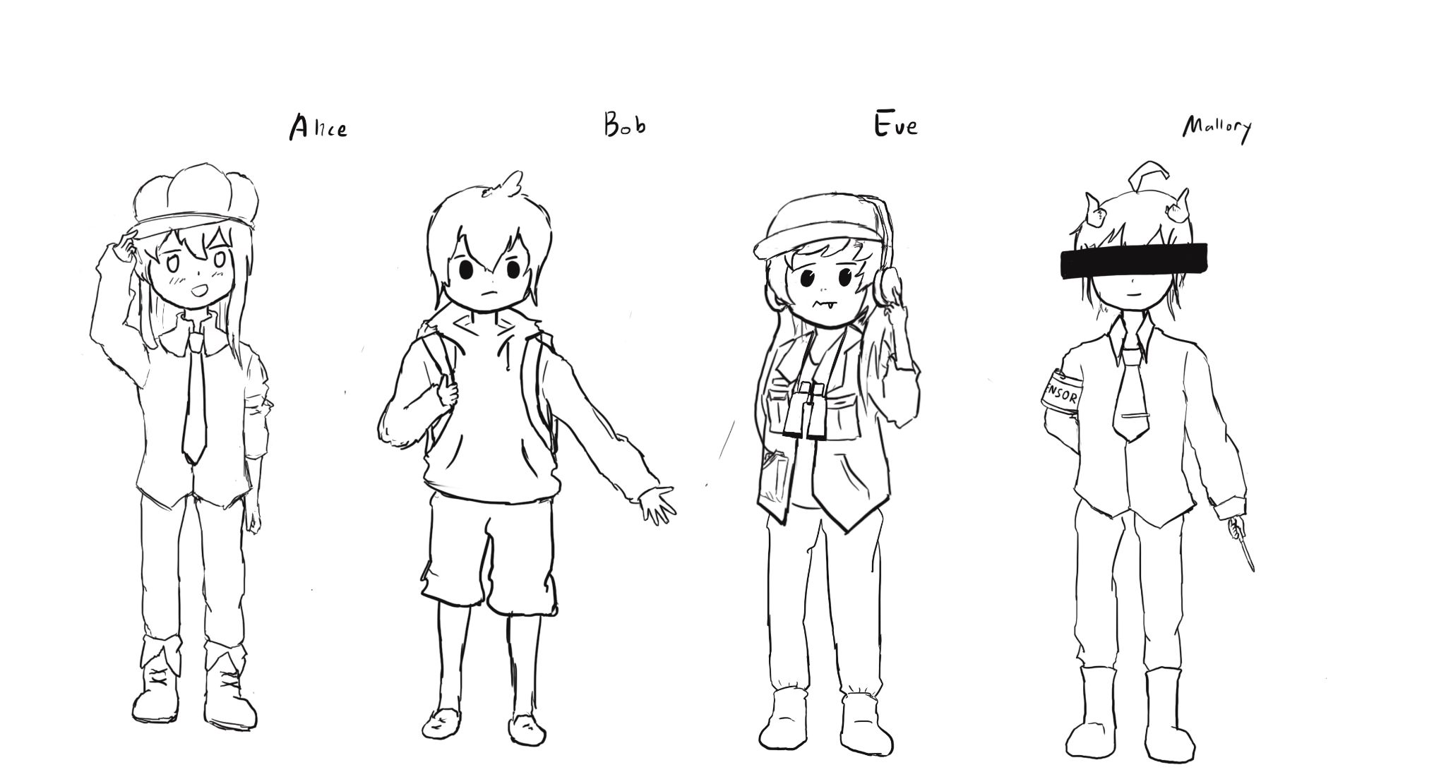
Meet Alice, Bob, Eve, and Mallory
Alice and Bob: The main characters trying to send messages to each other over an insecure communication channel
Carol and Dave can also join the party later
Eve: An eavesdropper who can read any data sent over the channel
Mallory: A manipulator who can read and modify any data sent over the channel

Slide 31
Meet Alice, Bob, Eve, and Mallory
We often describe cryptographic problems using a common cast of characters
One scenario:
Alice wants to send a message to Bob.
However, Eve is going to eavesdrop on the communication channel.
How does Alice send the message to Bob without Eve learning about the message?
Another scenario:
Bob wants to send a message to Alice.
However, Mallory is going to tamper with the communication channel.
How does Bob send the message to Alice without Mallory changing the message?

Slide 32
Three Goals of Cryptography
In cryptography, there are three main properties that we want on our data
Confidentiality: An adversary cannot read our messages.
Integrity: An adversary cannot change our messages without being detected.
Authenticity: I can prove that this message came from the person who claims to have written it.
Integrity and authenticity are closely related properties…
Before I can prove that a message came from a certain person, I have to prove that the message wasn’t changed!
… but they’re not identical properties
Later we’ll see some edge cases

Slide 33
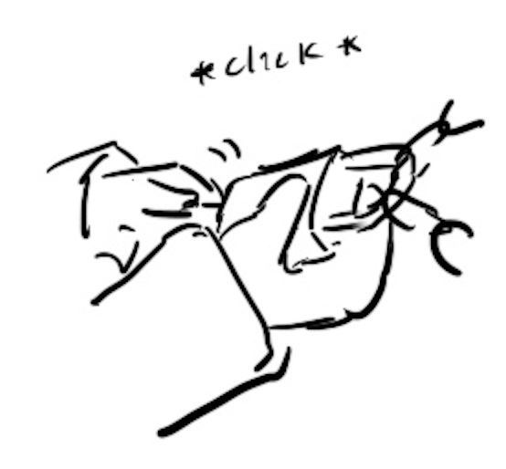
Keys
The most basic building block of any cryptographic scheme: The key
We can use the key in our algorithms to secure messages
Two models of keys:
Symmetric key model: Alice and Bob both know the value of the same secret key.
Asymmetric key model: Everybody has two keys, a secret key and a public key.
Example: You might remember RSA encryption from CS 70

Slide 34
Security Principle: Kerckhoff’s Principle
This principle is closely related to Shannon’s Maxim
Don’t use security through obscurity. Assume the attacker knows the system.
Kerckhoff’s principle says:
Cryptosystems should remain secure even when the attacker knows all internal details of the system
The key should be the only thing that must be kept secret
The system should be designed to make it easy to change keys that are leaked (or suspected to be leaked)
If your secrets are leaked, it is usually a lot easier to change the key than to replace every instance of the running software
Our assumption: The attacker knows all the algorithms we use. The only information the attacker is missing is the secret key(s).

Slide 35
Confidentiality
Confidentiality: An adversary cannot read our messages.
Analogy: Locking and unlocking the message
Alice uses the key to lock the message in a box
Alice sends the message (locked in the box) over the insecure channel
Eve sees the locked box, but cannot access the message without the key
Bob receives the message (locked in the box) and uses the key to unlock the message
Alice
Key
Insecure Channel
Key
Bob
Message
Lock
Message in locked box
Unlock
Message

Slide 36
Confidentiality
Schemes provide confidentiality by encrypting messages
Alice uses the key to encrypt the message: Change the message into a scrambled form
Alice sends the encrypted message over the insecure channel
Eve sees the encrypted message, but cannot figure out the original message without the key
Bob receives the encrypted message and uses the key to decrypt the message back into its original form
Alice
Key
Insecure Channel
Key
Bob
Message
Encryption Algorithm
Encrypted Message
Decryption Algorithm
Message

Slide 37
Confidentiality
Plaintext: The original message
Ciphertext: The encrypted message
Alice
Key
Insecure Channel
Key
Bob
Plaintext
Encryption Algorithm
Ciphertext
Decryption Algorithm
Plaintext

Slide 38
Integrity (and Authenticity)
Integrity: An adversary cannot change our messages without being detected.
Analogy: Adding a seal on the message
Alice uses the key to add a special seal on the message (e.g. puts tape on the envelope)
Alice sends the message and the seal over the insecure channel
If Mallory tampers with the message, she’ll break the seal (e.g. break the tape on the envelope)
Without the key, Mallory cannot create her own seal
Bob receives the message and the seal and checks that the seal has not been broken
Alice
Key
Insecure Channel
Key
Bob
Message
Create Seal
Message
Check Seal
Message
Seal

Slide 39
Integrity (and Authenticity)
Schemes provide integrity by adding a tag or signature on messages
Alice uses the key to generate a special tag for the message
Alice sends the message and the tag over the insecure channel
If Mallory tampers with the message, the tag will no longer be valid
Bob receives the message and the tag and checks that the tag is still valid
More on integrity in a future lecture
Alice
Key
Insecure Channel
Key
Bob
Message
Create Tag
Message
Check Tag
Message
Tag

Slide 40
Threat Models
What if Eve can do more than eavesdrop?
Real-world schemes are often vulnerable to more sophisticated attackers, so cryptographers have created more sophisticated threat models too
Some threat models for analyzing confidentiality:
 | Can Eve trick Alice into encrypting messages of Eve’s choosing? | Can Eve trick Bob into decrypting messages of Eve’s choosing?
Ciphertext-only | No | No
Chosen-plaintext | Yes | No
Chosen-ciphertext | No | Yes
Chosen plaintext-ciphertext | Yes | Yes

Slide 41
Threat Models
In this class, we’ll use the chosen plaintext attack model
In practice, cryptographers use the chosen plaintext-ciphertext model
It’s the most powerful
It can actually be defended against
 | Can Eve trick Alice into encrypting messages of Eve’s choosing? | Can Eve trick Bob into decrypting messages of Eve’s choosing?
Ciphertext-only | No | No
Chosen-plaintext | Yes | No
Chosen-ciphertext | No | Yes
Chosen plaintext-ciphertext | Yes | Yes

Slide 42
Cryptography Roadmap
 | Symmetric-key | Asymmetric-key
Confidentiality | One-time pads Block ciphers with chaining modes (e.g. AES-CBC) Stream ciphers | RSA encryption ElGamal encryption
Integrity, Authentication | MACs (e.g. HMAC) | Digital signatures (e.g. RSA signatures)
Hash functions
Pseudorandom number generators
Public key exchange (e.g. Diffie-Hellman)
Key management (certificates)
Password management

Slide 43

Symmetric-Key Encryption
Textbook Chapter 6.1

Slide 44
Cryptography Roadmap
 | Symmetric-key | Asymmetric-key
Confidentiality | One-time pads Block ciphers with chaining modes (e.g. AES-CBC) Stream ciphers | RSA encryption ElGamal encryption
Integrity, Authentication | MACs (e.g. HMAC) | Digital signatures (e.g. RSA signatures)
Hash functions
Pseudorandom number generators
Public key exchange (e.g. Diffie-Hellman)
Key management (certificates)
Password management

Slide 45
Symmetric-Key Encryption
The next few schemes are symmetric-key encryption schemes
Encryption schemes aim to provide confidentiality (but not integrity or authentication)
Symmetric-key means Alice and Bob share the same secret key that the attacker doesn’t know
Don’t worry about how Alice and Bob share the key for now
For modern schemes, we’re going to assume that messages are bitstrings
Bitstring: A sequence of bits (0 or 1), e.g. 11010101001001010
Text, images, etc. can usually be converted into bitstrings before encryption, so bitstrings are a useful abstraction. After all, everything in a computer is just a sequence of bits!

Slide 46
Symmetric-Key Encryption: Definition
A symmetric-key encryption scheme has three algorithms:
KeyGen() → K: Generate a key K
Enc(K, M) → C: Encrypt a plaintext M using the key K to produce ciphertext C
Dec(K, C) → M: Decrypt a ciphertext C using the key K
Alice
Key
Insecure Channel
Key
Bob
Plaintext
Encryption Algorithm
Ciphertext
Decryption Algorithm
Plaintext

Slide 47
Symmetric-Key Encryption: Definition
What properties do we want from a symmetric encryption scheme?
Correctness: Decrypting a ciphertext should result in the message that was originally encrypted
Dec(K, Enc(K, M)) = M for all K ← KeyGen() and M
Efficiency: Encryption/decryption algorithms should be fast: >1 Gbps on a standard computer
Security: Confidentiality
Alice
Key
Insecure Channel
Key
Bob
Plaintext
Encryption Algorithm
Ciphertext
Decryption Algorithm
Plaintext

Slide 48

Defining Confidentiality
Recall our definition of confidentiality from earlier: “An adversary cannot read our messages”
This definition isn’t very specific
What if Eve can read the first half of Alice’s message, but not the second half?
What if Eve figures out that Alice’s message starts with “Dear Bob”?
This definition doesn’t account for prior knowledge
What if Eve already knew that Alice’s message ends in “Sincerely, Alice”?
What if Eve knows that Alice’s message is “BUY!” or “SELL” but doesn't know which?

Slide 49
Defining Confidentiality
A better definition of confidentiality: The ciphertext should not give the attacker any additional information about the plaintext.
Let's design an experiment/security game to test our definition:
Eve chooses two messages M0 and M1 of the same length
Alice chooses one message at random Mb, encrypts it, and sends the ciphertext
Eve knows either M0 or M1 was sent, but doesn't know which
Eve reads the ciphertext and tries to guess which message was sent
If the probability that Eve correctly guesses which message was sent is 1/2, then the encryption scheme is confidential
Intuition
If the scheme is confidential, Eve can only guess with probability 1/2, which is no different than if Eve hadn’t sent the ciphertext at all
In other words: the ciphertext gave Eve no additional information about which plaintext was sent!
Notes:
Shafi and Silvio won Turing award for probabilistic encryption, proving the need for randomization, laying foundations for modern cryptography and much stronger guarantees

Slide 50
Defining Confidentiality: IND-CPA
Recall our threat model: Eve can also perform a chosen plaintext attack
Eve can trick Alice into encrypting arbitrary messages of Eve's choice
We can adapt our experiment to account for this threat model
A better definition of confidentiality: Even if Eve is able to trick Alice into encrypting messages, Eve can still only guess what message Alice sent with probability 1/2.
This definition is called IND-CPA (indistinguishability under chosen plaintext attack)
Cryptographic properties are often defined in terms of “games” that an adversary can either “win” or “lose”
We will use one to define confidentiality precisely

Slide 51
Defining Confidentiality: IND-CPA
Eve (adversary)
Alice (challenger)
Eve may choose plaintexts to send to Alice and receives their ciphertexts
M
(repeat)
Enc(K, M)

Slide 52
Defining Confidentiality: IND-CPA
Eve (adversary)
Alice (challenger)
Eve may choose plaintexts to send to Alice and receives their ciphertexts
Eve issues a pair of plaintexts M0 and M1 to Alice
M
(repeat)
Enc(K, M)
M0 and M1

Slide 53
Defining Confidentiality: IND-CPA
Eve (adversary)
Alice (challenger)
Eve may choose plaintexts to send to Alice and receives their ciphertexts
Eve issues a pair of plaintexts M0 and M1 to Alice
Alice randomly chooses either M0 or M1 to encrypt and sends the encryption back
Alice does not tell Eve which one was encrypted!
M
(repeat)
Enc(K, M)
M0 and M1
pick b
Enc(K, Mb)

Slide 54
Defining Confidentiality: IND-CPA
Eve (adversary)
Alice (challenger)
Eve may choose plaintexts to send to Alice and receives their ciphertexts
Eve issues a pair of plaintexts M0 and M1 to Alice
Alice randomly chooses either M0 or M1 to encrypt and sends the encryption back
Alice does not tell Eve which one was encrypted!
Eve may again choose plaintexts to send to Alice and receives their ciphertexts
M
(repeat)
Enc(K, M)
M0 and M1
pick b
Enc(K, Mb)
M
(repeat)
Enc(K, M)

Slide 55
Defining Confidentiality: IND-CPA
Eve (adversary)
Alice (challenger)
Eve may choose plaintexts to send to Alice and receives their ciphertexts
Eve issues a pair of plaintexts M0 and M1 to Alice
Alice randomly chooses either M0 or M1 to encrypt and sends the encryption back
Alice does not tell Eve which one was encrypted!
Eve may again choose plaintexts to send to Alice and receives their ciphertexts
Eventually, Eve outputs a guess as to whether Alice encrypted M0 or M1
M
(repeat)
Enc(K, M)
M0 and M1
pick b
Enc(K, Mb)
M
(repeat)
Enc(K, M)
Guess b = 0 or b = 1

Slide 56
Defining Confidentiality: IND-CPA
If Eve correctly guesses which message Alice encrypted, then Eve wins. Otherwise, she loses.
How does Eve guess whether M0 or M1 was encrypted? What strategy does she use?
We don’t assume she uses a particular strategy; Eve represents all possible strategies
Proving insecurity: There exists at least one strategy that can win the IND-CPA game with probability > 1/2
1/2 is the probability of winning by random guessing
If you can be better than random, then the ciphertext has leaked information, and Eve is able to learn it and use it to gain an advantage!
Proving security: For all attackers/Eve-s, the probability of winning the IND-CPA game is at most 1/2
Notes:
Ask: What if there is an adversary that can win with probability 0.4?

Slide 57
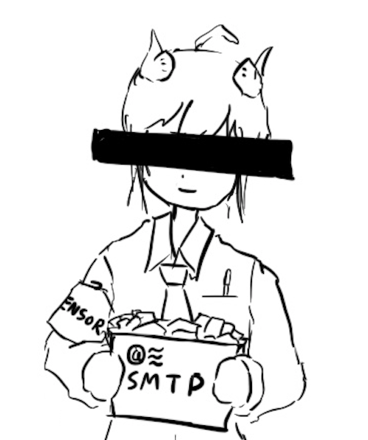
Edge Cases: Length
Cryptographic schemes are (usually) allowed to leak the length of the message
To hide length: All messages must always be the same length
16-byte messages: We can’t encrypt large messages (images, videos, etc.)!
1-GB messages: Sending small messages (text, Tweets, etc.) needs 1 GB of bandwidth!
This is unpractical
Applications that which to hide length must choose to pad their own messages to the maximum possible length before encrypting
In the IND-CPA game: M0 and M1 must be the same length
To break IND-CPA, Eve must learn something other than message length

Slide 58
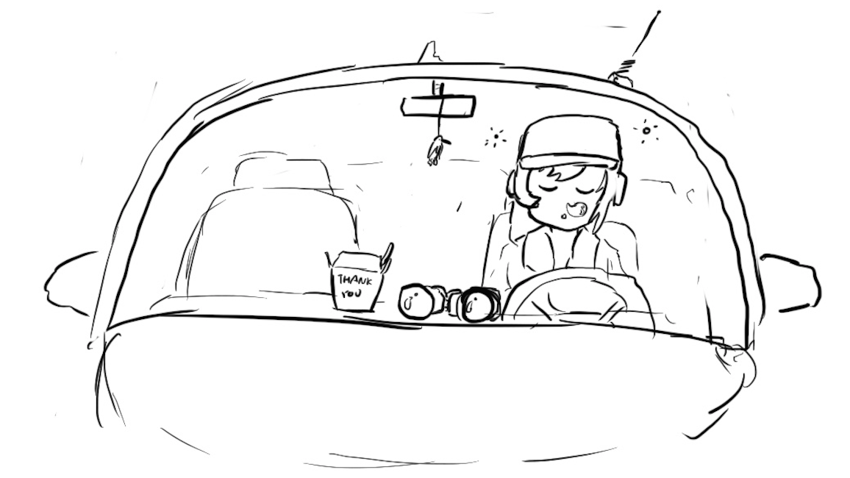
Edge Cases: Attacker Runtime
Some schemes are theoretically vulnerable, but secure in any real-world setting
If an attack takes longer than the life of the solar system to complete, it probably won’t happen!
Or if it would require a computer made out of a literal galaxy worth of science-fiction nanotech
In the IND-CPA game: Eve is limited to a practical runtime
One common practical limit: Eve is limited to polynomial runtime algorithms (no exponential-time algorithms)

Slide 59

Edge Cases: Negligible Advantage
Sometimes it’s possible for Eve to win with probability 1/2 + 1/2¹²⁸
This probability is greater than 1/2, but it's so close to 1/2 that it's as good as 1/2.
Eve's advantage is so small that she can't use it for any practical attacks
In the IND-CPA game: The scheme is secure even if Eve can win with probability ≤ 1/2 + Ɛ, where Ɛ is negligible
The actual mathematical definition of negligible is out of scope
Example: 1/2 + 1/2¹²⁸: Negligible advantage
Example: 2/3: Non-negligible advantage

Slide 60
Edge Cases: Negligible Advantage
Defining negligibility mathematically:
Advantage of the adversary should be exponentially small, based on the security parameters of the algorithm
Example: For an encryption scheme with a k-bit key, the advantage should be O(1/2^{k})
Defining negligibility practically:
A 1/2¹²⁸ probability is completely inconceivable
A 1/2²⁰ probability is fairly likely
“One in a million events happen every day in New York City”
In between these extremes, it can be messy
Different algorithms run faster or slower and have their own security parameters
Computers get more powerful over time
Recall: Know your threat model!
Takeaway: For now, 2⁸⁰ is a reasonable threshold, but this will change over time!

Slide 61

IND-CPA: Putting it together
Eve (adversary)
Alice (challenger)
Eve may choose plaintexts to send to Alice and receives their ciphertexts
Eve issues a pair of plaintexts M0 and M1 to Alice
Alice randomly chooses either M0 or M1 to encrypt and sends the encryption back
Alice does not tell Eve which one was encrypted!
Eve may again choose plaintexts to send to Alice and receives their ciphertexts
Eventually, Eve outputs a guess as to whether Alice encrypted M0 or M1
An encryption scheme is IND-CPA secure if for all polynomial time attackers Eve:
Eve can win with probability ≤ 1/2 + Ɛ, where Ɛ is negligible.
M
(repeat)
Enc(K, M)
M0 and M1
pick b
Enc(K, Mb)
M
(repeat)
Enc(K, M)
Guess b = 0 or b = 1
Notes:
Let’s stop to chew on this.

Slide 62
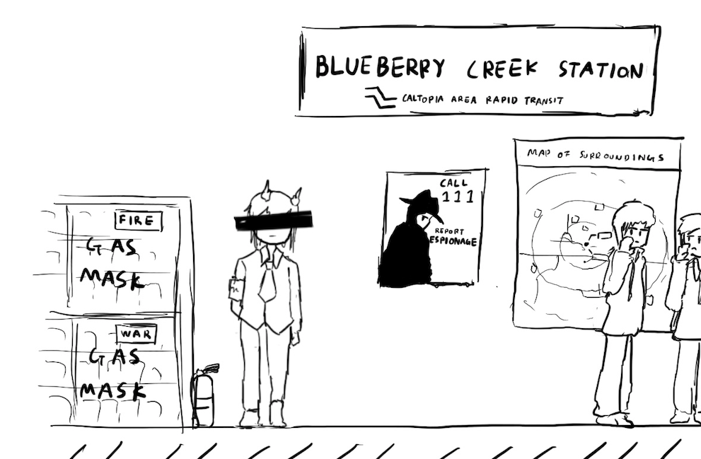
A Brief History of Cryptography
Textbook Chapter 5.2

Slide 63
Cryptography by Hand: Caesar Cipher
One of the earliest cryptographic schemes was the Caesar cipher
Used by Julius Caesar over 2,000 years ago
KeyGen():
Choose a key K randomly between 0 and 25
Enc(K, M):
Replace each letter in M with the letter K positions later in the alphabet
If K = 3, plaintext DOG becomes GRJ
Dec(K, C):
Replace each letter in C with the letter K positions earlier in the alphabet
If K = 3, ciphertext GRJ becomes DOG
K = 3
M | C | M | C
A | D | N | Q
B | E | O | R
C | F | P | S
D | G | Q | T
E | H | R | U
F | I | S | V
G | J | T | W
H | K | U | X
I | L | V | Y
J | M | W | Z
K | N | X | A
L | O | Y | B
M | P | Z | C

Slide 64
Cryptography by Hand: Attacks on the Caesar Cipher
Eve sees the ciphertext JCKN ECGUCT, but doesn’t know the key K
If you were Eve, how would you try to break this algorithm?
Brute-force attack: Try all 26 possible keys!
Use existing knowledge: Assume that the message is in English
+1 IBJM DBFTBS
+2 HAIL CAESAR
+3 GZHK BZDRZQ
+4 FYGJ AYCQYP
+5 EXFI ZXBPXO
+6 DWEH YWAOWN
+7 CVDG XVZNVM
+8 BUCF WUYMUL
+9 ATBE VTXLTK
+10 ZSAD USWKSJ
+11 YRZC TRVJRI
+12 XQYB SQUIQH
+13 WPXA RPTHPG
+14 VOWZ QOSGOF
+15 UNVY PNRFNE
+16 TMUX OMQEMD
+17 SLTW NLPDLC
+18 RKSV MKOCKB
+19 QJRU LJNBJA
+20 PIQT KIMAIZ
+21 OHPS JHLZHY
+22 NGOR IGKYGX
+23 MFNQ HFJXFW
+24 LEMP GEIWEV
+25 KDLO FDHVDU

Slide 65
Cryptography by Hand: Attacks on the Caesar Cipher
Eve sees the ciphertext JCKN ECGUCT, but doesn’t know the key K
Chosen-plaintext attack: Eve tricks Alice into encrypting plaintext of her choice
Eve sends a message M = AAA and receives C = CCC
Eve can deduce the key: C is 2 letters after A, so K = 2
Eve has the key, so she can decrypt the ciphertext

Slide 66
Cryptography by Hand: Substitution Cipher
A better cipher: create a mapping of each character to another character.
Example: A = N, B = Q, C = L, D = Z, etc.
Unlike the Caesar cipher, the shift is no longer constant!
KeyGen():
Generate a random, one-to-one mapping of characters
Enc(K, M):
Map each letter in M to the output according to the mapping K
Dec(K, C):
Map each letter in C to the output according to the reverse of the mapping K
K
M | C | M | C
A | N | N | G
B | Q | O | P
C | L | P | T
D | Z | Q | A
E | K | R | J
F | R | S | O
G | V | T | D
H | U | U | I
I | E | V | C
J | S | W | F
K | B | X | M
L | W | Y | X
M | Y | Z | H

Slide 67
Cryptography by Hand: Attacks on Substitution Ciphers
Does the brute-force attack still work?
There are 26! ≈ 2⁸⁸ possible mappings to try
Too much for most modern computers… for now
How about the chosen-plaintext attack?
Trick Alice into encrypting ABCDEFGHIJKLMNOPQRSTUVWXYZ, and you’ll get the whole mapping!
Another strategy: cryptanalysis
The most common english letters in text are E, T, A, O, I, N
K
M | C | M | C
A | N | N | G
B | Q | O | P
C | L | P | T
D | Z | Q | A
E | K | R | J
F | R | S | O
G | V | T | D
H | U | U | I
I | E | V | C
J | S | W | F
K | B | X | M
L | W | Y | X
M | Y | Z | H

Slide 68
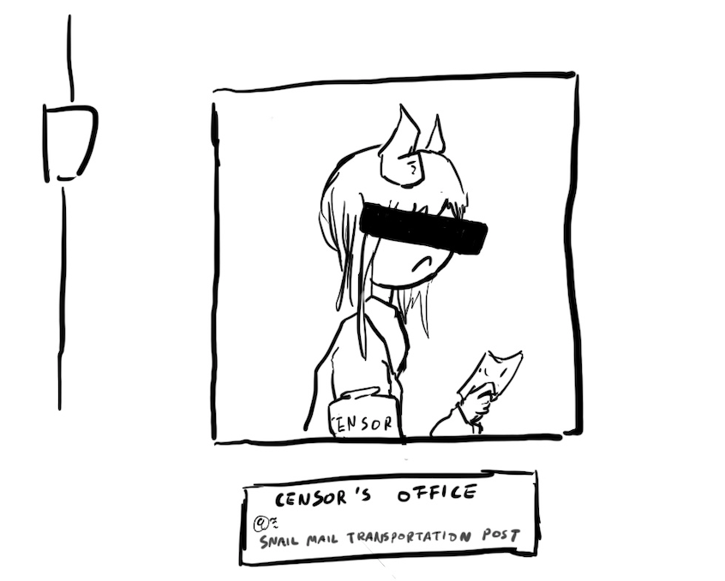
Takeaways
Cryptography started with paper-and-pencil algorithms (Caesar cipher)
Then cryptography moved to machines (Enigma)
Finally, cryptography moved to computers (which we’re about to study)
Hopefully you gained some intuition for some of the cryptographic definitions

Slide 69
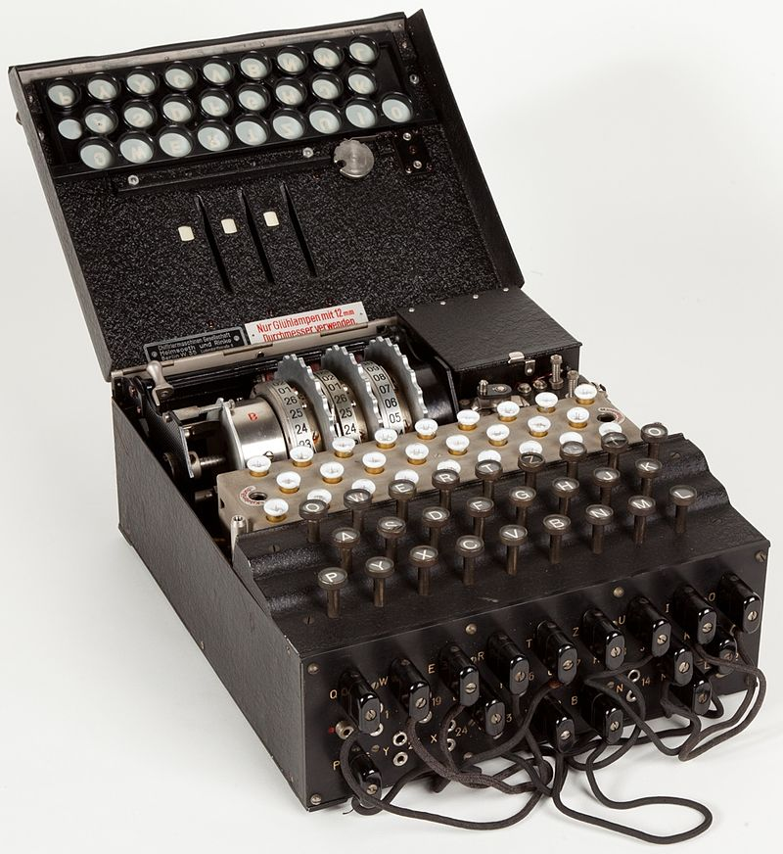

Cryptography by Machines: Enigma
A mechanical encryption machine used by the Germans in WWII
Rotors
Plugboard

Slide 70
Enigma Operating Principle: Rotor Machine
The encryption core was composed of 3 or 4 rotors
Each rotor was a fixed permutation (e.g. A maps to F, B maps to Q...)
And the end was a "reflector", a rotor that sent things backwards
Plus a fixed-permutation plugboard
A series of rotors were arranged in a sequence
Each keypress would generate a current from the input to one light for the output
Each keypress also advanced the first rotor
When the first rotor makes a full rotation, the second rotor advances one step
When the second rotor makes a full rotation, the third rotor advances once step

Slide 71
Cryptography by Machines: Enigma
KeyGen():
Choose rotors, rotor orders, rotor positions, and plugboard settings
158,962,555,217,826,360,000 possible keys
Enc(K, M) and Dec(K, C):
Input the rotor settings K into the Enigma machine
Press each letter in the input, and the lampboard will light up the corresponding output letter
Encryption and decryption are the same algorithm!
Germans believed that Enigma was an “unbreakable code”

Slide 72
Cryptography by Machines: Enigma
Eve (adversary)
Alice (challenger)
Enigma has a significant weakness: a letter never maps to itself!
No rotor maps a letter to itself
The reflector never maps a letter to itself
This property is necessary for Enigma’s mechanical system to work
What pair of messages should Eve send to Alice in the challenge phase?
Send M0 = A^{k}, M1 = B^{k}
M0 is a string of k 'A' characters, M1 is a string of k 'B' characters
How can Eve probably know which message Alice encrypted?
If there are no 'A' characters, it was M0
If there are no 'B' characters, it was M1
M
(repeat)
Enc(K, M)
M0 and M1
pick b
Enc(K, Mb)
M
(repeat)
Enc(K, M)
Guess b = 0 or b = 1

Slide 73
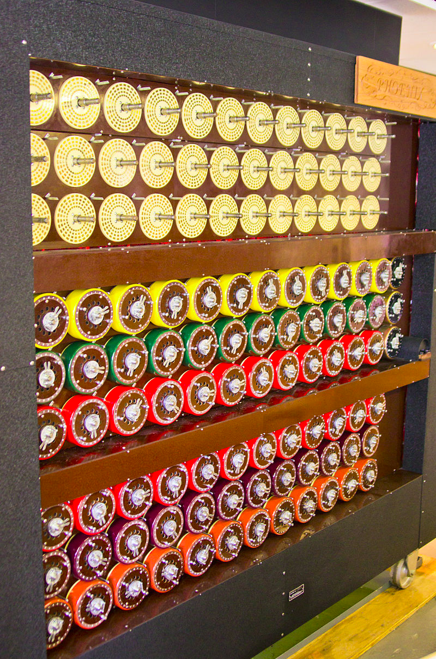
Cryptography by Machines: Attack on Enigma
Polish and British cryptographers built BOMBE, a machine to brute-force Enigma keys
Why was Enigma breakable?
Kerckhoff’s principle: The Allies stole Enigma machines, so they knew the algorithm
Known plaintext attacks: the Germans often sent predictable messages (e.g. the weather report every morning)
Chosen plaintext attacks: the Allies could trick the Germans into sending a message (e.g. “newly deployed minefield”)
Brute-force: BOMBE would try many keys until the correct one was found
Plus a weakness: You'd be able to try multiple keys with the same hardware configuration
BOMBE machine

Slide 74

Cryptography by Machines: Legacy of Enigma
Alan Turing, one of the cryptographers who broke Enigma, would go on to become one of the founding fathers of computer science
Most experts agree that the Allies breaking Enigma shortened the war in Europe by about a year
Alan Turing

Slide 75


Cryptography by Computers
The modern era of cryptography started after WWII, with the work of Claude Shannon
“New Directions in Cryptography” (1976) showed how number theory can be used in cryptography
Its authors, Whitfield Diffie and Martin Hellman, won the Turing Award in 2015 for this paper
This is the era of cryptography we’ll be focusing on
One of these is Diffie, and the other one is Hellman.

Slide 76
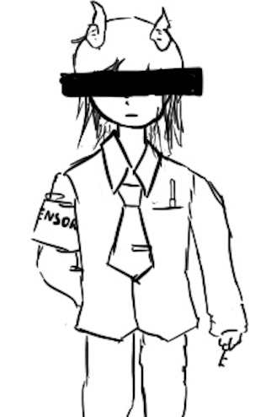
One-Time Pads
Textbook Chapter 6.2 & 6.3

Slide 77
Cryptography Roadmap
 | Symmetric-key | Asymmetric-key
Confidentiality | One-time pads Block ciphers with chaining modes (e.g. AES-CBC) Stream ciphers | RSA encryption ElGamal encryption
Integrity, Authentication | MACs (e.g. HMAC) | Digital signatures (e.g. RSA signatures)
Hash functions
Pseudorandom number generators
Public key exchange (e.g. Diffie-Hellman)
Key management (certificates)
Password management

Slide 78
Review: XOR
The XOR operator takes two bits and outputs one bit:
Useful properties of XOR:
0 ⊕ 0 = 0
0 ⊕ 1 = 1
1 ⊕ 0 = 1
1 ⊕ 1 = 0
x ⊕ 0 = x
x ⊕ x = 0
x ⊕ y = y ⊕ x
(x ⊕ y) ⊕ z = x ⊕ (y ⊕ z)
(x ⊕ y) ⊕ x = y

Slide 79
Review: XOR Algebra
Algebra works on XOR too
y ⊕ 1 = 0 | Goal: Solve for y
y ⊕ 1 ⊕ 1 = 0 ⊕ 1 | XOR both sides by 1
y = 1 | Simplify with identities

Slide 80
One-Time Pads: Key Generation
Alice
K
0 | 1 | 1 | 0 | 0 | 1 | 0 | 1 | 0 | 1 | 1 | 1
The key K is a randomly-chosen bitstring.
Recall: We are in the symmetric-key setting, so we’ll assume Alice and Bob both know this key.

Slide 81
One-Time Pads: Encryption
Alice
K
0 | 1 | 1 | 0 | 0 | 1 | 0 | 1 | 0 | 1 | 1 | 1
M
1 | 0 | 0 | 1 | 1 | 0 | 0 | 1 | 0 | 1 | 0 | 0
The plaintext M is the bitstring that Alice wants to encrypt.
Idea: Use XOR to scramble up M with the bits of K.

Slide 82
One-Time Pads: Encryption
Alice
K
0 | 1 | 1 | 0 | 0 | 1 | 0 | 1 | 0 | 1 | 1 | 1
⊕ | ⊕ | ⊕ | ⊕ | ⊕ | ⊕ | ⊕ | ⊕ | ⊕ | ⊕ | ⊕ | ⊕
M
1 | 0 | 0 | 1 | 1 | 0 | 0 | 1 | 0 | 1 | 0 | 0
↓ | ↓ | ↓ | ↓ | ↓ | ↓ | ↓ | ↓ | ↓ | ↓ | ↓ | ↓
C
1 | 1 | 1 | 1 | 1 | 1 | 0 | 0 | 0 | 0 | 1 | 1
Encryption algorithm: XOR each bit of K with the matching bit in M.
The ciphertext C is the encrypted bitstring that Alice sends to Bob over the insecure channel.

Slide 83
One-Time Pads: Decryption
Bob
K
0 | 1 | 1 | 0 | 0 | 1 | 0 | 1 | 0 | 1 | 1 | 1
C
1 | 1 | 1 | 1 | 1 | 1 | 0 | 0 | 0 | 0 | 1 | 1
Bob receives the ciphertext C. Bob knows the key K. How does Bob recover M?

Slide 84
One-Time Pads: Decryption
Bob
K
0 | 1 | 1 | 0 | 0 | 1 | 0 | 1 | 0 | 1 | 1 | 1
⊕ | ⊕ | ⊕ | ⊕ | ⊕ | ⊕ | ⊕ | ⊕ | ⊕ | ⊕ | ⊕ | ⊕
C
1 | 1 | 1 | 1 | 1 | 1 | 0 | 0 | 0 | 0 | 1 | 1
↓ | ↓ | ↓ | ↓ | ↓ | ↓ | ↓ | ↓ | ↓ | ↓ | ↓ | ↓
M
1 | 0 | 0 | 1 | 1 | 0 | 0 | 1 | 0 | 1 | 0 | 0
Decryption algorithm: XOR each bit of K with the matching bit in C.

Slide 85
One-Time Pad
KeyGen()
Randomly generate an n-bit key, where n is the length of your message
Recall: For today, we assume that Alice and Bob can securely share this key
For one-time pads, we generate a new key for every message
Enc(K, M) = K ⊕ M
Bitwise XOR M and K to produce C
In other words: XOR the ith bit of the plaintext with the ith bit of the key.
Ci = Ki ⊕ Mi
Alice and Bob use a different key for each encryption (this is the “one-time” in one-time pad).
Dec(K, C) = K ⊕ C
Bitwise XOR C and K to produce M
Mi = Ki ⊕ Ci
Notes:
Ask students if they can produce the decryption equation before showing it to them

Slide 86
One-Time Pad: Correctness
Correctness: If we encrypt and then decrypt, we should get the original message back
Enc(K, M) | = | K ⊕ M | Definition of encryption
Dec(K, Enc(K, M)) | = | Dec(K, K ⊕ M) | Decrypting the ciphertext
 | = | K ⊕ (K ⊕ M) | Definition of decryption
 | = | M | XOR property

Slide 87
One-Time Pad: Security
Recall our definition of confidentiality: The ciphertext should not give the attacker any additional information about the plaintext
Recall our experiment to test confidentiality from earlier:
Alice has encrypted and sent either M0 or M1
Eve knows either M0 or M1 was sent, but doesn't know which
Eve reads the ciphertext and tries to guess which message was sent
If the probability that Eve correctly guesses which message was sent is 1/2, then the encryption scheme is confidential

Slide 88
One-Time Pad: Security
Possibility 0: Alice sends Enc(K, M0)
Possibility 1: Alice sends Enc(K, M1)
The ciphertext is C = K ⊕ M0
Therefore, K = C ⊕ M0
The ciphertext is C = K ⊕ M1
Therefore, K = C ⊕ M1
K was chosen randomly, so both possibilities are equally possible
Eve has learned no new information, so the scheme is perfectly secure

Slide 89
Two-Time Pads?
Alice
K
Insecure Channel
M0
OTP Enc
K ⊕ M0
Eve sees two ciphertexts over the insecure channel.
K
M1
OTP Enc
K ⊕ M1
What if we use the same key K to encrypt two different messages?

Slide 90
Two-Time Pads?
Alice
K
Insecure Channel
Eve
M0
OTP Enc
K ⊕ M0
(K ⊕ M0) ⊕ (K ⊕ M1) = M0 ⊕ M1
K
⊕
M1
OTP Enc
K ⊕ M1
If Eve XORs the two ciphertexts, she learns M0 ⊕ M1!

Slide 91
Two-Time Pads?
What if we use the same key twice?
Alice encrypts M0 and M1 with the same key
Eve observes K ⊕ M0 and K ⊕ M1
Eve computes (K ⊕ M0) ⊕ (K ⊕ M1) = M0 ⊕ M1
Recall the XOR property: the K's cancel out
Eve has learned M0 ⊕ M1. This is partial information about the messages!
In words, Eve knows which bits in M0 match bits in M1
If Eve knows M0, she can deduce M1 (and vice-versa)
Eve can also guess M0 and check that M1 matches her guess for M0
Result: One-time pads are not secure if the key is reused
Alice and Bob must use a different key for every message!

Slide 92
Impracticality of One-Time Pads
Problem #1: Key generation
For security to hold, keys must be randomly generated for every message, and never reused
Randomness is expensive, as we’ll see later
Problem #2: Key distribution
To communicate an n-bit message, we need to securely communicate an n-bit key first
But if we have a way to securely communicate an n-bit key, we could have communicated the message directly!
Only practical application: Communicate keys in advance
You have a secure channel now, but you won’t have it later
Use the secure channel now to communicate keys in advance
Use one-time pad later to communicate over the insecure channel
And people can compute this by hand without computers!

Slide 93
One-Time Pads in Practice: Spies
At home base, the spy obtains a large amount of key material (e.g. a book of random bits)
In the field, the spy listens for secret messages from their home country
There are shortwave and terrestrial radio “number stations”
At a regular time, a voice gets on the air and reads a series of numbers
If you don’t know the key, this looks like a meaningless sequence of random numbers
If you know the key, you can decrypt the spy message!
What if you don’t want to send anything to any spies?
Read out a list of random numbers anyway
Because one-time pad leaks no information, an eavesdropper can’t distinguish between an encrypted message and random numbers!

Slide 94
Two-Time Pads in Practice: VENONA
Soviet spies used one-time pads for communication from their spies in the US
During WWII, the Soviets started reusing key material
Uncertain whether it was just the cost of generating pads or what…
VENONA was a US cryptanalysis project designed to break these messages
Included confirming/identifying the spies targeting the US Manhattan project
Project continued until 1980!
Not declassified until 1995!
So secret even President Truman wasn’t informed about it
The Soviets found out about it in 1949 through their spy Ken Philby, but their one-time pad reuse was fixed after 1948 anyway
Takeaway: Otherwise-secure cryptographic systems can fail very badly if used improperly!
Notes:
TODO Nick

Slide 95
Summary
What’s cryptography?
Communicating securely over insecure channels
You should never write your own crypto! Use existing libraries instead.
Definitions
Alice and Bob want to send messages over an insecure channel. Eve can read anything sent over the insecure channel. Mallory can read or modify anything sent over the insecure channel.
We want to ensure confidentiality (adversary can’t read message), integrity (adversary can’t modify message), and authenticity (prove message came from sender)
Crypto uses secret keys. Kerckhoff’s principle says to assume the attacker knows the entire system, except the secret keys.
There are several different threat models. We’ll focus on the chosen plaintext attack, where Eve tricks Alice into encrypting some messages.

Slide 96
Summary
IND-CPA security
Even if Eve can trick Alice into encrypting some messages of Eve’s choosing, given the encryption of either M0 or M1, Eve cannot distinguish which message was sent with probability greater than 1/2.
We can use the IND-CPA game to test for IND-CPA security
Edge cases: IND-CPA secure schemes can leak length. Eve is limited to polynomial-time algorithms, and must have a non-negligible advantage to win.
One-time pads
Symmetric encryption scheme: Alice and Bob share a secret key.
Encryption and decryption: Bitwise XOR with the key.
No information leakage if the key is never reused.
Information leaks if the key is reused.
Impractical for real-world usage, unless you’re a spy.

